Slide 1
Network Theorems
4.1 Superposition Theorem and Reciprocity
4.2 Source Transformation, Thevenin’s and Norton’s Theorem
4.3 Millman’s Theorem
4.3 Maximum Power Transfer Theorem
4.4 Substitution Theorem
4.5 Compensation Theorem
Prof. P. Singh
Network Theorems NIT Rourkela

Slide 2
SUPERPOSITION THEOREM
Prof. P. Singh
Network Theorems NIT Rourkela

Slide 3
Superposition Theorem
Superposition : the voltage across (or current through) an element in a linear circuits is the algebraic sum of the voltage across (or current through) that element due to each independent source acting alone.
Current Source → open circuit(0 A)
Voltage Source → short circuit (0 V)
Prof. P. Singh
Network Theorems NIT Rourkela

Slide 4
Superposition Theorem
Step to apply:
  Turn off all independent sources except one source. Find the output (voltage or current) due to that active source.
  Repeat step 1 for each other independent sources.
  Find the total contribution by adding algebraically all the contribution due to the independent source.
Prof. P. Singh
Network Theorems NIT Rourkela

Slide 5
SOURCE TRANSFORMATION
Prof. P. Singh
Network Theorems NIT Rourkela

Slide 6
Source Transformation
Source transformation : replacing a voltage source v_{s} in series with a impedance Z by a current source i_{s} in parallel with a impedance Z, or vice versa.
Prof. P. Singh
Network Theorems NIT Rourkela

Slide 7

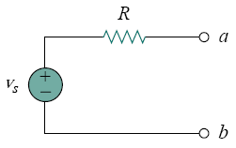
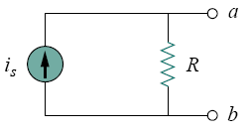
Prof. P. Singh
Network Theorems NIT Rourkela

Slide 8
THEVENIN’S THEOREM
Prof. P. Singh
Network Theorems NIT Rourkela

Slide 9
Thevenin’s Theorem
Thevenin’s theorem : a linear two terminal circuit can be replaced by an equivalent circuit consisting of a voltage V_{Th} in series with an impedance Z_{Th} , where V_{Th} is the open circuit voltage at the terminals and Z_{Th} is the input or equivalent impedance at the terminals when the independent source are turned off.
Prof. P. Singh
Network Theorems NIT Rourkela

Slide 10

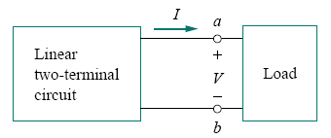
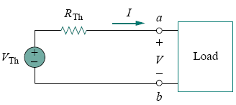
Prof. P. Singh
Network Theorems NIT Rourkela

Slide 11
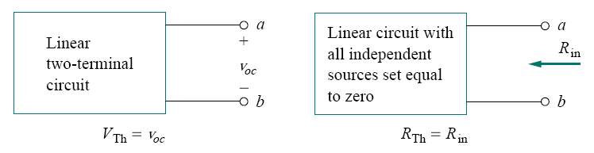
Finding VTh and ZTh
Prof. P. Singh
Network Theorems NIT Rourkela

Slide 12
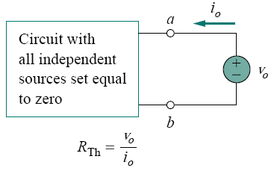
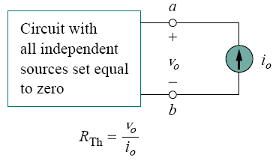
Z
Finding ZTh when circuit has dependent sources
Prof. P. Singh
Network Theorems NIT Rourkela

Slide 13
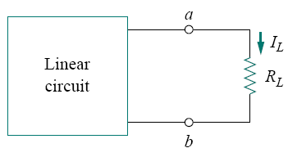
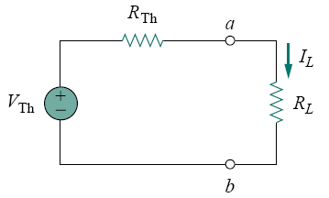
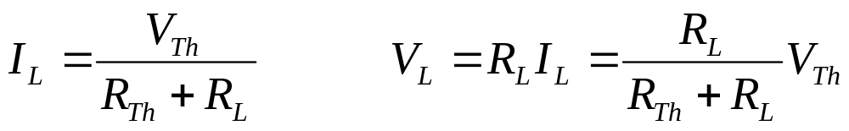
Thevenin’s Theorem
Circuit with load
Prof. P. Singh
Network Theorems NIT Rourkela

Slide 14
NORTON’S THEOREM
Prof. P. Singh
Network Theorems NIT Rourkela

Slide 15
Norton’s Theorem
Norton’s Theorem : a linear two-terminal circuit can be replaced by an equivalent circuit consisting of a current source I_{N} in parallel with an impendence Z_{N}, where I_{N} is the short circuit current through the terminals and Z_{N} is the input or equivalent impedance at the terminals when the independent source are turned off.
Prof. P. Singh
Network Theorems NIT Rourkela

Slide 16
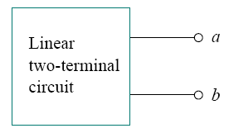
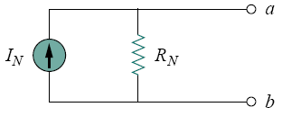
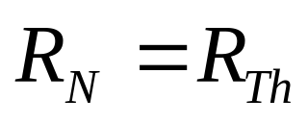
Norton’s Theorem
Prof. P. Singh
Network Theorems NIT Rourkela

Slide 17
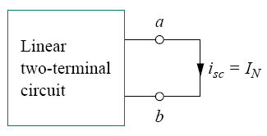
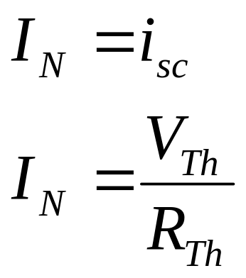
Norton’s Theorem
Finding Norton current I_{N}.
Prof. P. Singh
Network Theorems NIT Rourkela

Slide 18
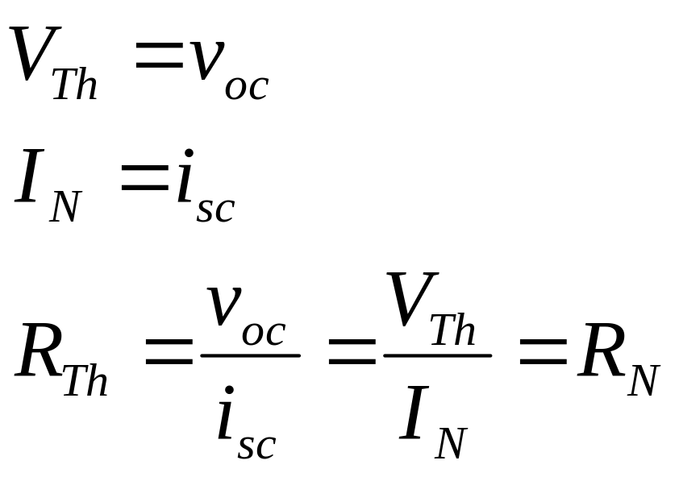
Thevenin and Norton Equivalent
Prof. P. Singh
Network Theorems NIT Rourkela

Slide 19
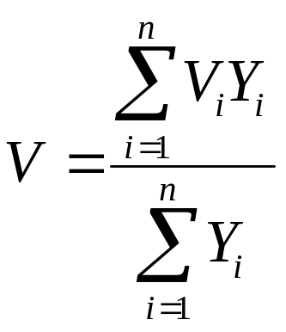
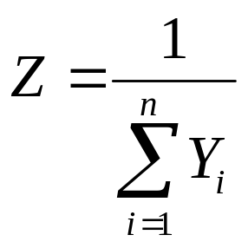
Millman’s Theorem
A number of voltage sources in parallel can be replaced by a single ideal voltage source V in series with an impedance Z where
Prof. P. Singh
Network Theorems NIT Rourkela

Slide 20
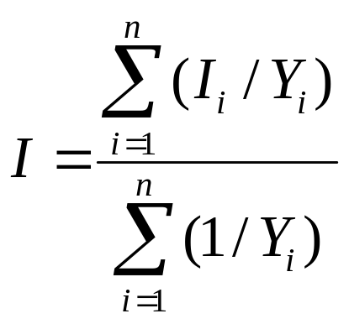
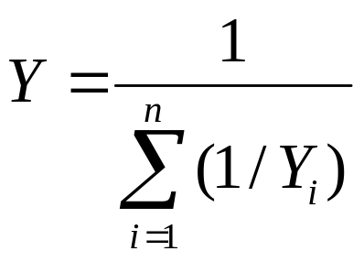
Millman’s Theorem
A number of current sources in series can be replaced by a single ideal current source I in parallel with an impedance Z where
Prof. P. Singh
Network Theorems NIT Rourkela

Slide 21
MAXIMUM POWER TRANSFER THEOREM
Prof. P. Singh
Network Theorems NIT Rourkela

Slide 22
Maximum Power Transfer Theorem
Maximum power : transferred to the load when the load resistance equals the Thevenin resistance as seen from the load
RL = RTh
Maximum power : transferred to the load when the load impedance equals the conjugate of the Thevenin impedance as seen from the load
ZL = Z*Th
Prof. P. Singh
Network Theorems NIT Rourkela

Slide 23
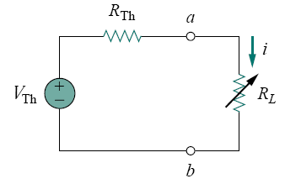
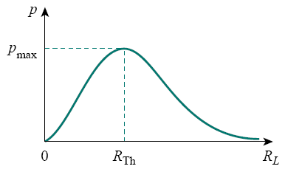
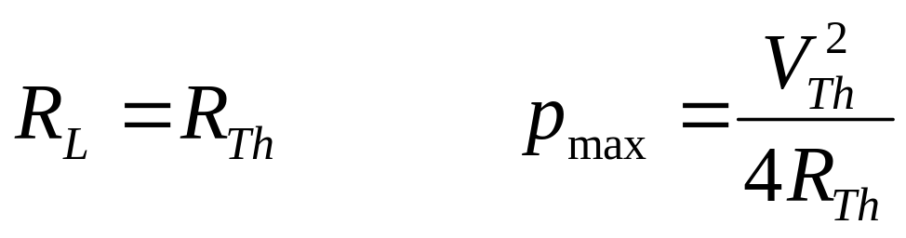
Maximum Power Transfer
Prof. P. Singh
Network Theorems NIT Rourkela

